Slide 1

NCLEX:
OVERVIEW & APPLICATION PROCESS
NORTH DAKOTA BOARD OF NURSING

Slide 2
NURSING LAW & RULES
LAW
    North Dakota Century Code (NDCC)
    Chapter 43-12.1
    NURSE PRACTICES ACT
RULES
North Dakota Administrative Code (NDAC)
Title 54
BOARD OF NURSING

Slide 3
NDBON Mission
- Public Protection -
To assure ND citizens quality nursing care and promote public safety through the regulation of standards for nursing education, licensure, and practice.

Slide 4



NCLEX PARTNERS
NDBON
www.ndbon.org
National Council of State Boards of Nursing NCSBN
www.ncsbn.org/nclex
Pearson VUE
NCLEX Candidate Services
www.pearsonvue.com/nclex

Slide 5
National Council Licensure Examination (NCLEX)
The NCLEX has been given via computer since April 1994. Offered only in computerized adaptive testing (CAT) format, with no paper-and-pencil format option.
Item types include multiple-choice, multiple-response, fill-in-the-blank, exhibit, drag & drop/ordered response, and graphic items.
Testers are encouraged to review the NCLEX tutorial which instructs how to answer the different types of items you will see. Available on the NCSBN website at NCLEX Tutorial | NCSBN.
On-screen calculator available during exam.

Slide 6
National Council Licensure Examination (NCLEX)
Exam designed to test knowledge, skills & abilities essential to safe, effective nursing practice at the ENTRY level.
NCLEX-RN & NCLEX-PN include 15 unscored pretest items (questions). The minimum number of scored questions for each exam is 70 and the maximum is 135 (total number questions answered 85-150). Time limit is five (5) hours.
Note that time allotted for exam includes breaks & the exam. All breaks are optional.

Slide 7
ATTENTION!
Skipping or reviewing questions is not permitted
Changing answers is not permitted

Slide 8
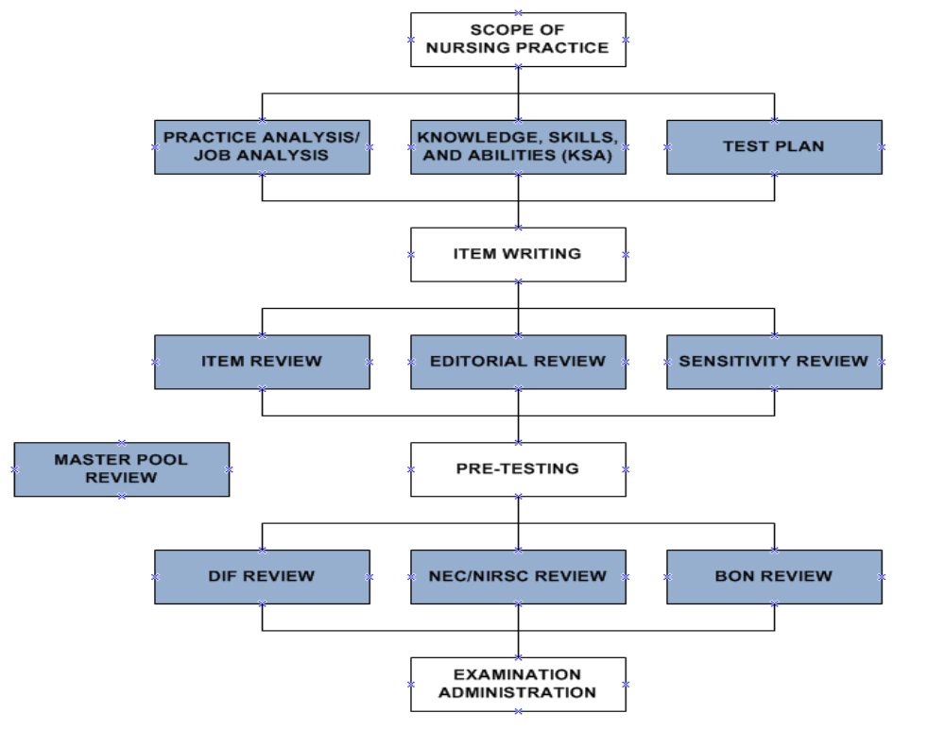
It takes more than 4,895 nurses and 200,000 future nurses to create the NCLEX!
NCLEX Development Process
≈ 4,700 Nurses
≈ 60 Nurses
≈ 60 Nurses
≈ 25 Nurses
≈ 200,000 Future Nurses
≈ 50 Nurses

Slide 9
RN INTEGRATED PROCESSES
Nursing Process
Caring
Communication and Documentation
Teaching and Learning
Culture and Spirituality
Clinical Judgment
Current NCLEX-RN Test Plan is effective April 1, 2023, through March 31, 2026

Slide 10
RN TEST PLAN
Client Needs | % of Items from Each Category/Subcategory
Safe & Effective Care Environment
Management of Care | 15-21%
Safety & Infection Control | 10-16%
Health Promotion & Maintenance | 6-12%
Psychosocial Integrity | 6-12%
Physiological Integrity
Basic Care & Comfort | 6-12%
Pharmacological & Parenteral Therapies | 13-19%
Reduction of Risk Potential | 9-15%
Physiological Adaptation | 11-17%

Slide 11
PN INTEGRATED PROCESSES
Nursing Process
Caring
Communication and Documentation
Teaching and Learning
Culture and Spirituality
Clinical Judgment
Current NCLEX-PN Test Plan is effective April 1, 2023, through March 31, 2026

Slide 12
PN TEST PLAN
Client Needs | % of Items from Each Category/Subcategory
Safe & Effective Care Environment
Coordinated Care | 18-24%
Safety & Infection Control | 10-16%
Health Promotion & Maintenance | 6-12%
Psychosocial Integrity | 9-15%
Physiological Integrity
Basic Care & Comfort | 7-13%
Pharmacological Therapies | 10-16%
Reduction of Risk Potential | 9-15%
Physiological Adaptation | 7-13%

Slide 13
ACCOMMODATIONS
Certain accommodations are possible if a candidate:
  Has a disability as defined by the Americans with Disabilities Act, and
  Has been previously diagnosed by a healthcare professional, and
  Has had accommodations while in nursing program, and
  Submits the appropriate documentation to the NDBON for review and approval

Slide 14

EXAM & LICENSURE PROCESS IS COMPLETELY ONLINE
ON-LINE EXAM, ENDORSEMENT AND RENEWAL APPLICATION
ON-LINE APPLICATION STATUS
ON-LINE VERIFICATION

Slide 15
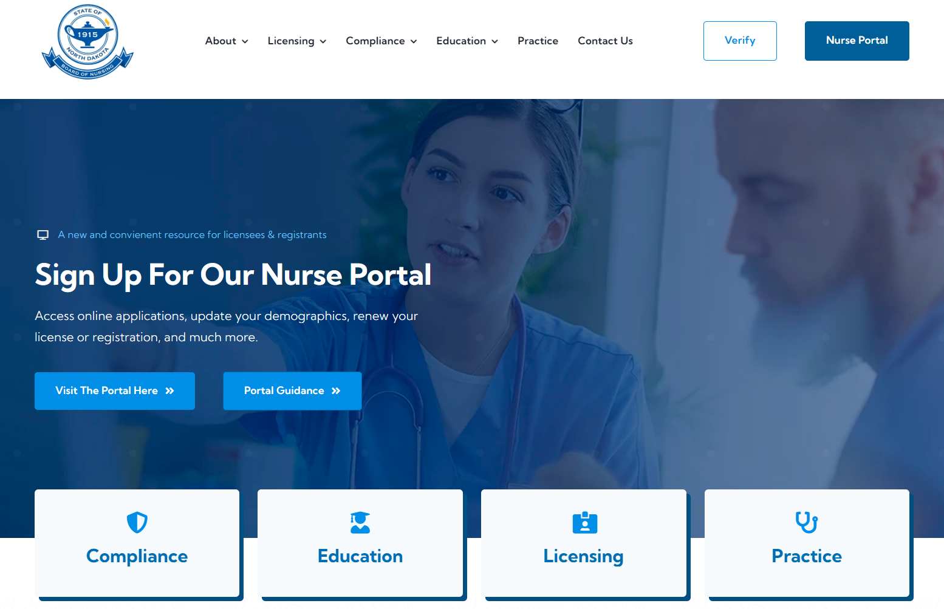
BOARD OF NURSING WEBSITE
ABOUT
LICENSING
COMPLIANCE
EDUCATION
PRACTICE
VERIFY
NURSE PORTAL

Slide 16
EXAM ELIGIBILITY REQUIREMENTS
Complete on-line application with appropriate fee
Official transcript with degree posted sent directly to ND Board of Nursing from program
Candidate registers with NCLEX Candidate Services www.pearsonvue.com/nclex
Print and complete UPDATED Criminal History Record Check (CHRC) form and follow directions for fingerprinting.

Slide 17
ELIGIBILITY PROCESS
ND Board of Nursing reviews application and transcript for completeness
Candidate registers with NCLEX Candidate Services (Pearson VUE)
NDBON forwards eligibility to test to Pearson VUE
NDBON posts 90-day work authorization on NDBON Verification Portal website: License Lookup

Slide 18
NDBON LICENSURE APPLICATION
Candidate completes NDBON License by Examination application on-line in the ND Nurse Portal.
Pay $145 via debit or credit card Visa/MC/Discover gift or cash cards (Fees are non-refundable)

Slide 19
OFFICIAL TRANSCRIPTS
Official Transcripts required AFTER DEGREE AWARDED AND COMPLETION-GRADUATION DATE is POSTED.
Transcripts will be accepted through secure third-party electronic transcript service such as e-Scrip-Safe, National Student Clearinghouse, or Parchment.

Slide 20
CRIMINAL HISTORY RECORD CHECK (CHRC)
Print & complete CHRC forms located on the NDBON website under the Licensing drop-down tab, then click the Criminal History Record Checks selection under Licensing Resources.
Criminal History Record Check (CHRC) – ND Board of Nursing
Print and use the CHRC Checklist and CHRC forms (SFN 60688 & 62550) in “Related Information: Forms & Documents” at the bottom of the page to avoid rejections.
Contact BCI-approved fingerprint vendor for hours of fingerprinting or to set up an appointment.
The fee for actual fingerprinting will vary depending agency.

Slide 21
INK & ROLL FINGERPRINTING
If your fingerprints are done by ink and roll, you will need to submit the following to the Board of Nursing:
CHRC forms #60688 and #62550
    Form #62550 MUST be signed by the agency doing the fingerprinting
Two (2) completed fingerprint cards (Be sure cards are completed, signed and dated by the individual doing the fingerprinting)
  Money order, cashiers check, or personal check payable to the ND Attorney General in the EXACT amount of $40.00.

Slide 22
ELECTRONIC FINGERPRINTING
If your fingerprints are done electronically, you will need to submit the following to the Board of Nursing:
CHRC forms #60688 and #62550
    Form #62550 MUST be signed by the agency doing the fingerprinting
One (1) completed fingerprint card if electronic (This means the fingerprints are electronically scanned and printed onto the fingerprint cards. Still required to mail the hard copy of the fingerprint cards which must be completed, signed and dated by the individual doing the fingerprinting)
  Money order, cashiers check, or personal check payable to the ND Attorney General in the EXACT amount of $40.00.

Slide 23
CRIMINAL HISTORY RECORD CHECK
Both federal and state checks will be performed. If fingerprints are not adequate for identification purposes the NDBON will notify you.
If second set of prints are not adequate for identification purposes, a name search will be requested.
Processing time averages ten days if first set of fingerprints are adequate.

Slide 24
CRIMINAL HISTORY RECORD CHECK
Work authorization will be issued, and test can be scheduled prior to CHRC results.
CHRC results must be received in the Board office before results of licensing examination will be issued.
If candidate passes examination and CHRC results are not completed candidate can continue to work as GN or GPN under the 90-day work authorization until CHRC results are received or the work authorization expires.

Slide 25
NCLEX REGISTRATION PROCESS
Candidate registers with NCLEX Candidate Services by telephone or website
Pearson VUE e-mails candidate acknowledgement of receipt
NDBON determines candidate’s eligibility
Pearson VUE e-mails candidate Authorization to Test (ATT) (must have e-mail address)
Candidate schedules test date on-line or via phone and chooses desired Pearson Professional Center location

Slide 26
NCLEX REGISTRATION OPTIONS
INTERNET
  www.pearsonvue.com/nclex and select “Registration”
  Payment of $200 fee by credit or debit card, VISA, MC, or American Express
PHONE
  Call 1-866-496-2539 Monday – Friday 7 a.m. to 7 p.m.
  Payment of $200 fee by credit or debit card, Visa, MC, or American Express

Slide 27

COMMON REGISTRATION ERRORS
Type of examination
  Registered Nurse
  Practical Nurse
State of licensure
  Must be the same state candidate applied for licensure
Pearson VUE will charge $50.00 fee to
correct these errors

Slide 28
TRACK APPLICATION STATUS
To Track the Status of your application at www.ndbon.org in your NURSE PORTAL.

Slide 29
SCHEDULING AN
APPOINTMENT TO TEST
Candidate receives ATT from Pearson VUE via e-mail (ATT valid for 90 days)
Candidate calls or schedules online for a testing date and time at desired Pearson Professional Center location
First choice or close alternative offered
Appointment confirmation will be e-mailed
NOTE: NCLEX retake policy requires 45 days between attempts for repeat testers

Slide 30
CANCELING/CHANGING AN APPOINTMENT TO TEST
All appointments may be canceled or changed by calling Pearson VUE or visiting the NCLEX Candidate website
24 hours notice required for any changes or cancellations or $200.00 fee will be forfeited

Slide 31
SITE SECURITY - ADMISSION
Arrive at Pearson Professional Center 30 minutes before scheduled testing time
Present valid identification (unexpired photo ID)
First name & last name on photo ID must match name on Electronic ATT
Palm-vein scan taken
Photograph taken

Slide 32
SITE SECURITY - ADMISSION
Video/audio monitoring at test center
All personal items must be stored in your locker
All electronic devices (cell phones, smart watches, fitness bands, etc.) must be placed in a provided plastic bag. Best to leave these items at home. They may not be accessed during the exam (including breaks).
Palm vein scan taken when enter and leave testing room.

Slide 33
IN THE EVENT OF NAME MISMATCH
Must bring legal name change document to test center:
  Marriage license
  Divorce decree
  Court action legal name change document
Must notify Board of Nursing of name change

Slide 34
NAME & ADDRESS CHANGES
Use the same address when registering with Pearson VUE and the ND Board of Nursing. This should be the address where you currently reside.
Change your name and/or address in your NURSE PORTAL profile at www.ndbon.org any time a change occurs.
The Board of Nursing will update your information in the Pearson VUE Registration for ATT.

Slide 35
REST BREAKS
An optional break will be offered after approximately 2 hours of testing- you will be prompted by the computer
Second optional break offered after approximately 3 ½ hours of testing- you will be prompted by the computer

Slide 36
CONFIDENTIALITY OF EXAMINATION
Candidates should be aware & understand that disclosure of exam questions before, during or after the exam is a violation of law.
Violations of confidentiality and/or candidate rules can result in criminal prosecution or civil liability and/or disciplinary actions, including denial of licensure.
If aware of or observed attempts to compromise the NCLEX process, report immediately to NCSBN.

Slide 37
NCSBN NCLEX
RETAKE POLICY
Candidates who need to retake the NCLEX must have 45 days test-free between each exam attempt, which allows candidates to take the NCLEX eight times per year.
The NCLEX Retake Policy requires a 45 day wait period due to the limited number of questions available for each exam at any given time, and prevention of overexposure of questions to maintain exam integrity.

Slide 38
WORK AUTHORIZATION FOR THE GRADUATE NURSE
A work authorization allows the graduate nurse or graduate practical nurse to be employed according to NDBON guidelines.
Must complete application process within 60 days of graduation to be eligible for work authorization.
Work authorization expires 90 days after the date of issue or upon notification of NCLEX results, whichever comes first.

Slide 39
WORK AUTHORIZATION PROCESS
NDBON notifies Pearson VUE of candidate eligibility via computer
NDBON posts work authorization number, issue date and expiration date on web.
To view work authorization at www.ndbon.org:Under VERIFY or in your NURSE PORTAL

Slide 40
GRADUATE NURSE
PRACTICE GUIDELINES
A work authorization is required for any nursing practice including orientation of a graduate nurse (GN) or graduate practical nurse (GPN).
The GN or GPN must practice under the supervision of a RN.
The GN or GPN must not be assigned to function in clinical leadership roles where on-unit supervision is not available.
The GN or GPN shall not be employed in administrative positions that require licensed personnel.
NDBON Guidelines for Employment of Graduate Nurses before Licensure – ND Board of Nursing

Slide 41
SUMMARY OF PROCESS:
LICENSE BY EXAMINATION
Candidate
On-line application for license by examination, $145 nonrefundable fee
  Request school to send electronic transcript through third party vendor or mail transcript with degree posted to NDBON
  NCLEX registration with NCLEX Candidate Services (Pearson VUE)
  Have fingerprints completed for CHRC by approved agency and return to NDBON prior to testing

Slide 42
SUMMARY OF PROCESS:
LICENSE BY EXAMINATION
ND Board of Nursing
  Declares candidate eligible to test when official transcript received, and fees paid, and applications are complete with NDBON and Pearson VUE
  Graduate Work Authorization posted in NURSE PORTAL profile (Expires 90 days after issued or when test is taken - failed or passed)

Slide 43
SUMMARY OF PROCESS:
LICENSE BY EXAMINATION
NCLEX Candidate Services (Pearson VUE)
  E-mails Authorization to Test (ATT) to candidate – valid for 90 days

Slide 44
SUMMARY OF PROCESS
FOLLOWING RECEIPT OF ATT
Candidate
  Calls the Pearson Professional Center of choice and makes appointment to test OR
  Visit Pearson VUE website to schedule appointment.
  If desires to cancel/change appointment, must contact Pearson VUE 24 hours prior or forfeit ATT.
  Calls the NDBON office if any problems with scheduling NCLEX examination.

Slide 45
SUMMARY OF PROCESS
FOLLOWING RECEIPT OF ATT
ND Board of Nursing
  Results of the examination emailed to candidate within 1 to 3 days of testing
  PLEASE DO NOT CALL THE NDBON FOR RESULTS. Test results will not be provided over the telephone.
  Quick Results Service available for ND testers. Available for $7.95 on Pearson VUE website.

Slide 46
QUESTIONS?
Pearson VUE
Website: www.pearsonvue.com/nclex
Call: 1.866.496.2539
Email: pvamericascustomerservice@pearson.com
Address:
NCLEX Examination Program
Pearson Professional Testing
5601 Green Valley Dr.
Bloomington, MN 55437-1099
NCSBN
Website: www.ncsbn.org
Call: 1.866.293.9600
Email: nclexinfo@ncsbn.org
Address: National Council of State Boards of Nursing, Inc. Examinations Department111 E. Wacker Dr.
Suite 2900
Chicago, IL 60601-4277

Slide 47
QUESTIONS?
Contact the NDBON
education@ndbon.org
Board office located at:
919 S. 7th St.
Suite 504
Bismarck, ND 58504-5881
701.989.1276
Also, refer to 2025 NCLEX Examination Candidate Bulletin for more information
NORTH DAKOTA BOARD OF NURSING

